Slide 1
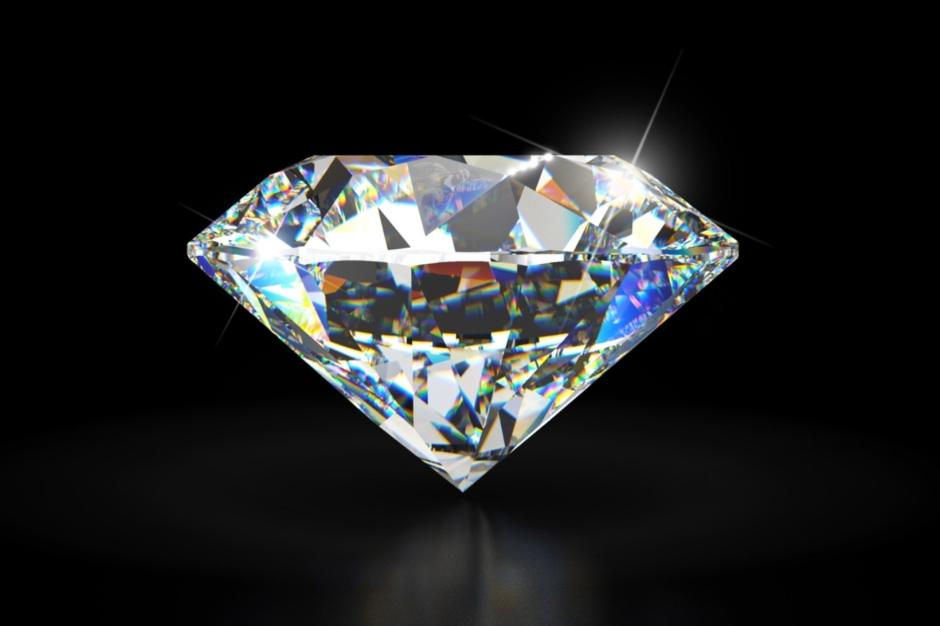
Diamond Price Prediction
Nour Mohamed
Youssef Abbas
Abdelrahman Medhat
Maryam Walid

Slide 2
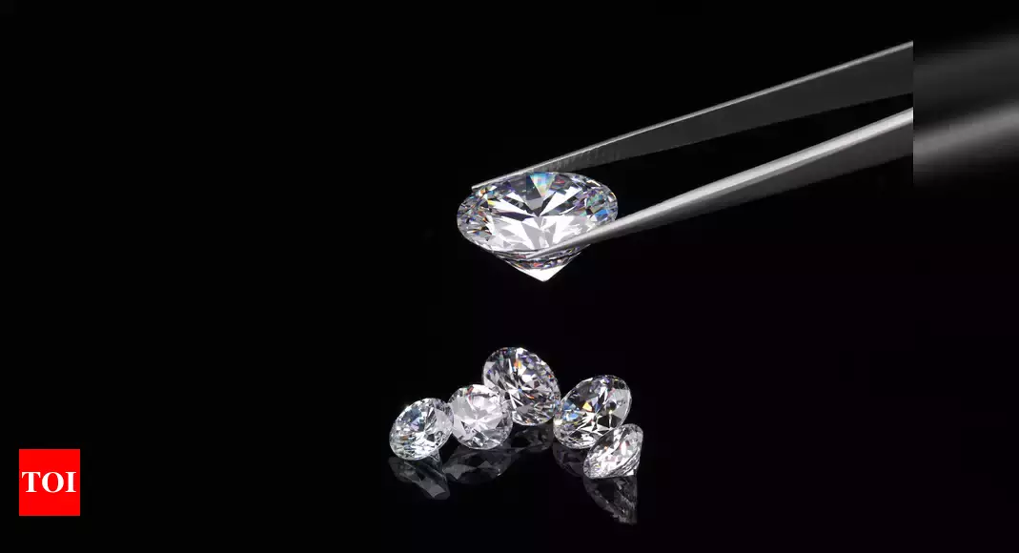
Agenda
Problem Definition
Used Dataset
Preparation & Preprocessing
Methods
Results
Conclusion

Slide 3
Problem Definition
Diamond merchants were facing a problem in determining the price of a diamond because many features are to be considered for determining its price.
In this project, we aim to produce the most efficient model for the price prediction of diamonds.
This model should work based on previously trained and analyzed data about diamond type, carat, cut, color, clarity, depth, prices, etc. as each of these feature's effects the diamond price differently depending on its weight.
This model will be trained and updated until it reaches the highest accuracy possible compared to human error

Slide 4
Used Dataset
Dataset Name: Diamonds Prices
There are 53,940 diamonds in the dataset with 10 features (carat, cut, color, clarity, depth, table, price, x, y, and z). Most variables are numeric in nature, but the variables cut, color, and clarity are ordered factor variables with the following levels.
The columns X, Y, and Z they are diamond measurements as (( X: length in mm, Y: width in mm, Z: depth in mm ))
Dataset Link: https://www.kaggle.com/datasets/nancyalaswad90/diamonds-prices

Slide 5
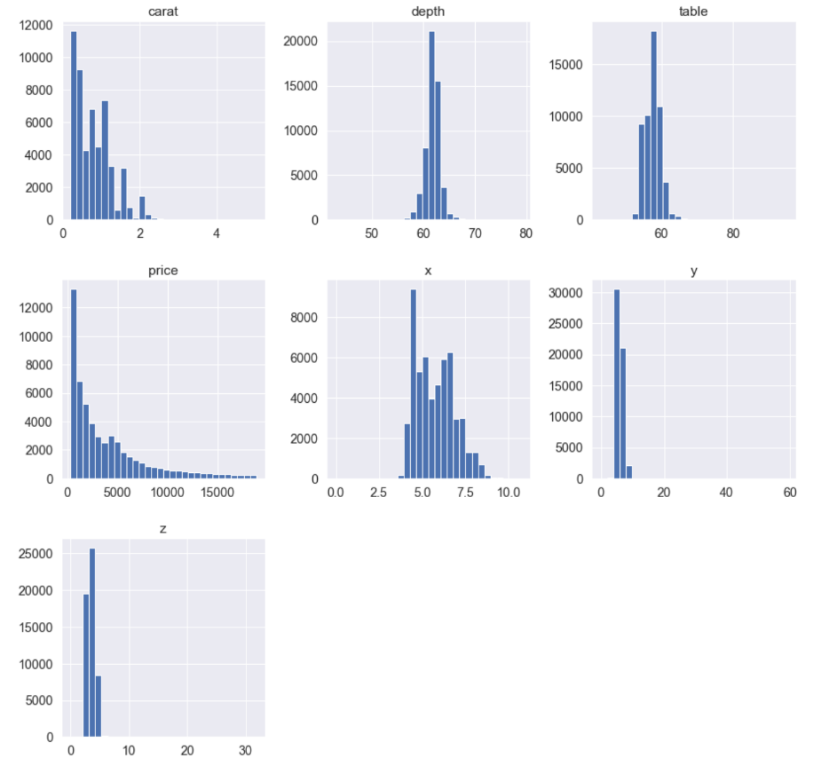
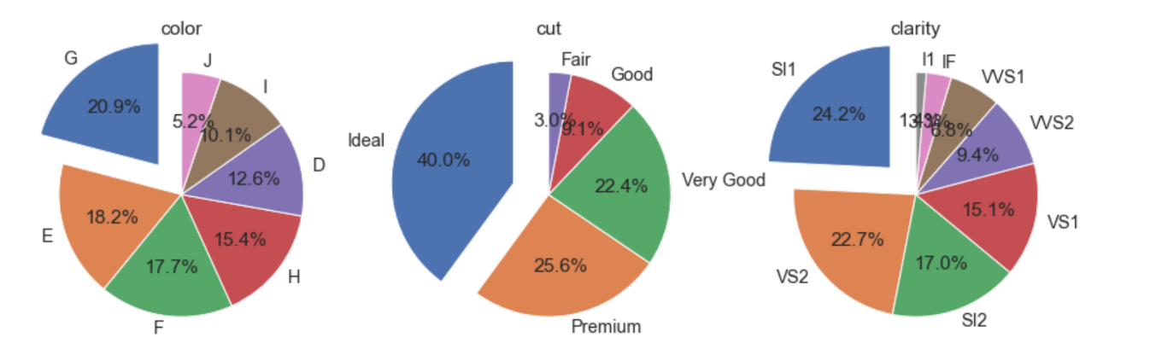
Preparations & Preprocessing
Categorical data
Numerical data

Slide 6
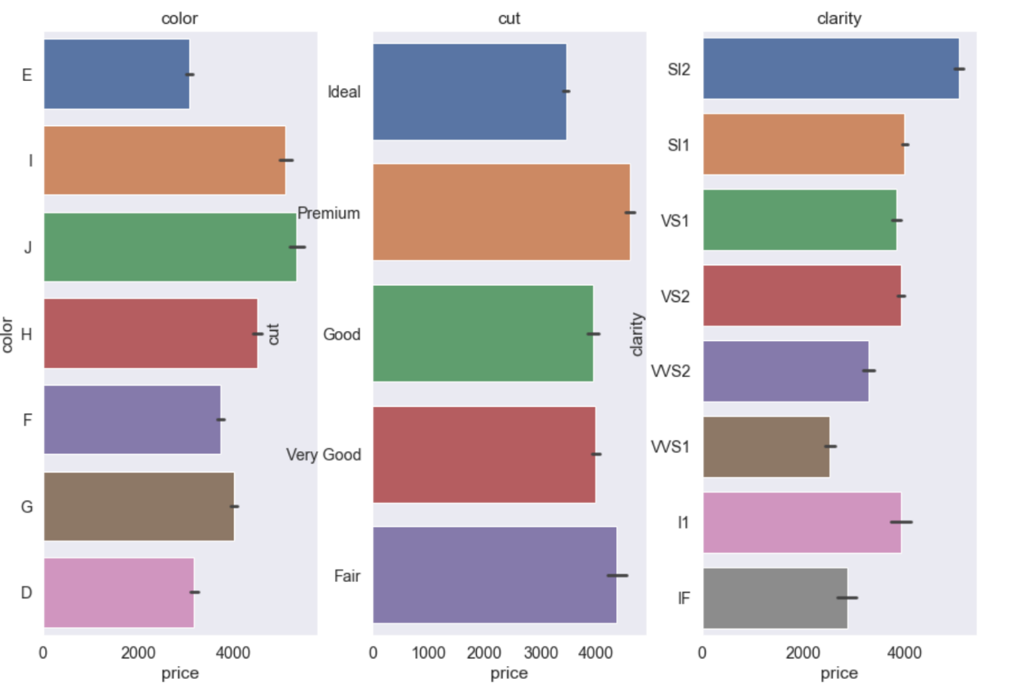
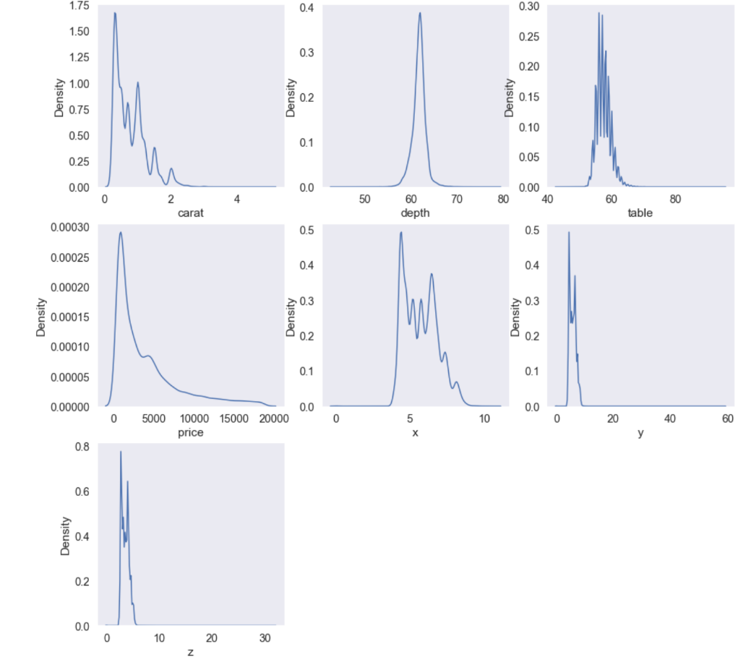
Preparations & Preprocessing
Categorical data
Numerical data

Slide 7
Methods
We used Jupyter and Google Colab
libraries imported: numpy, pandas, and seaborn to visualize the data
We used dataset from Kaggle
We analyzed and visualized our dataset

Slide 8
Results
We used three Models: Linear Regression, Decision Tree Regressor, Random Forest Regressor
Linear Regression: Accuracy = 92.344 Mean Squared Error = 0.278554
Decision Tree Regressor: Accuracy = 96.536 Mean Squared Error = 0.187384
Random Forest Regressor: Accuracy = 97.909 Mean Squared Error = 0.145573

Slide 9
Conclusion
We found that the third model (Random Forest Regressor) is the best with the highest Accuracy and lowest Mean Square Error

